Slide 1
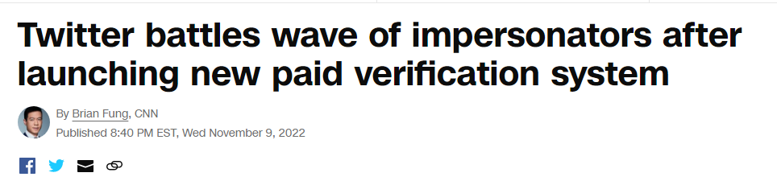
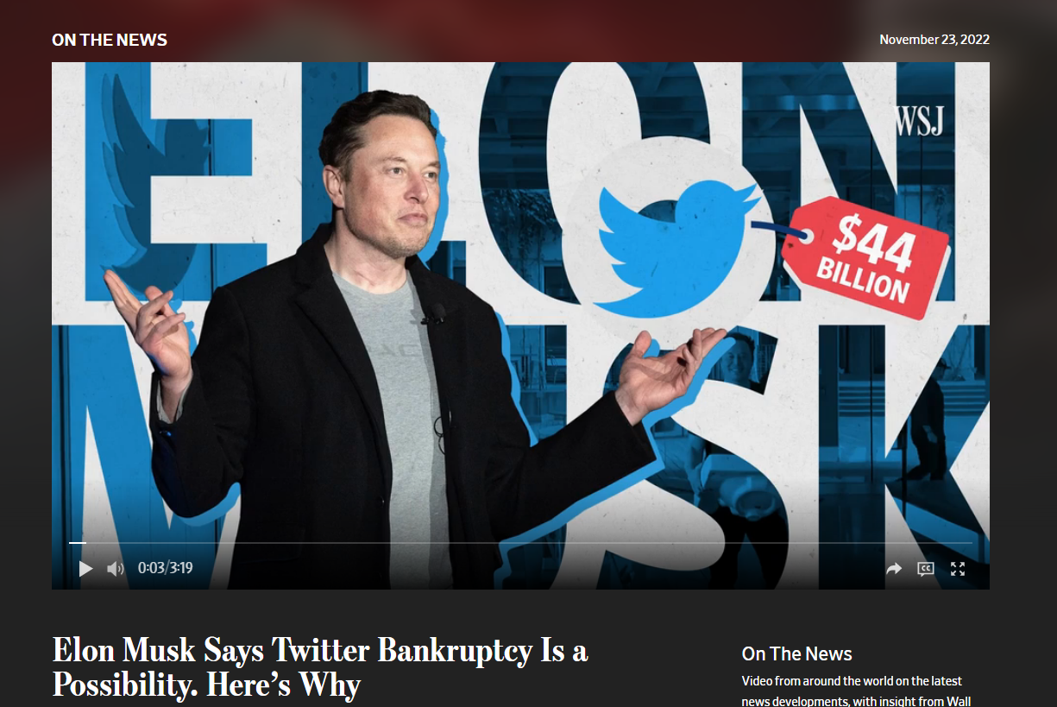
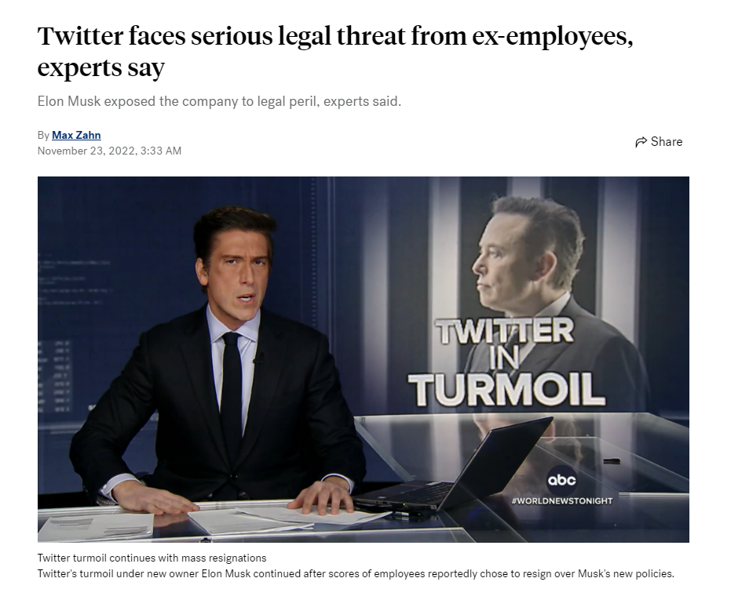
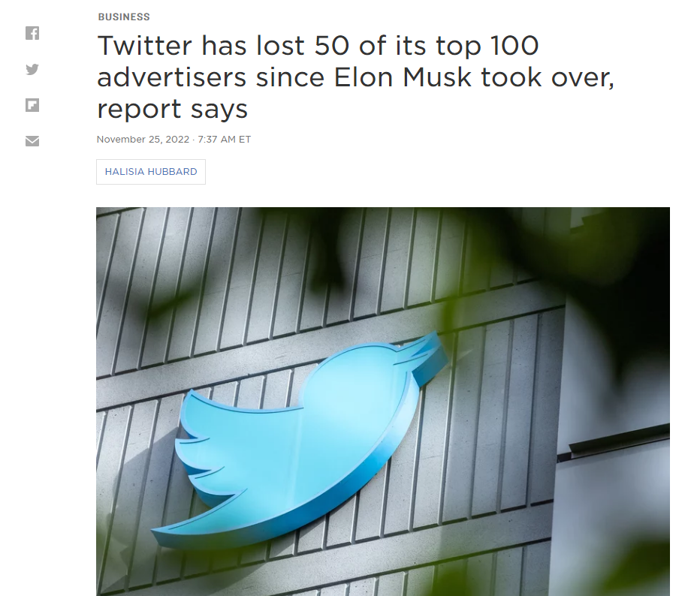
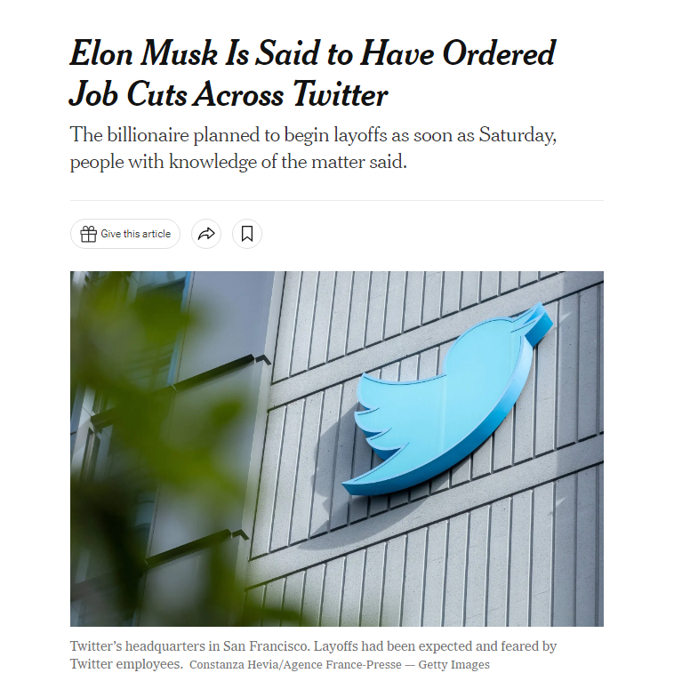
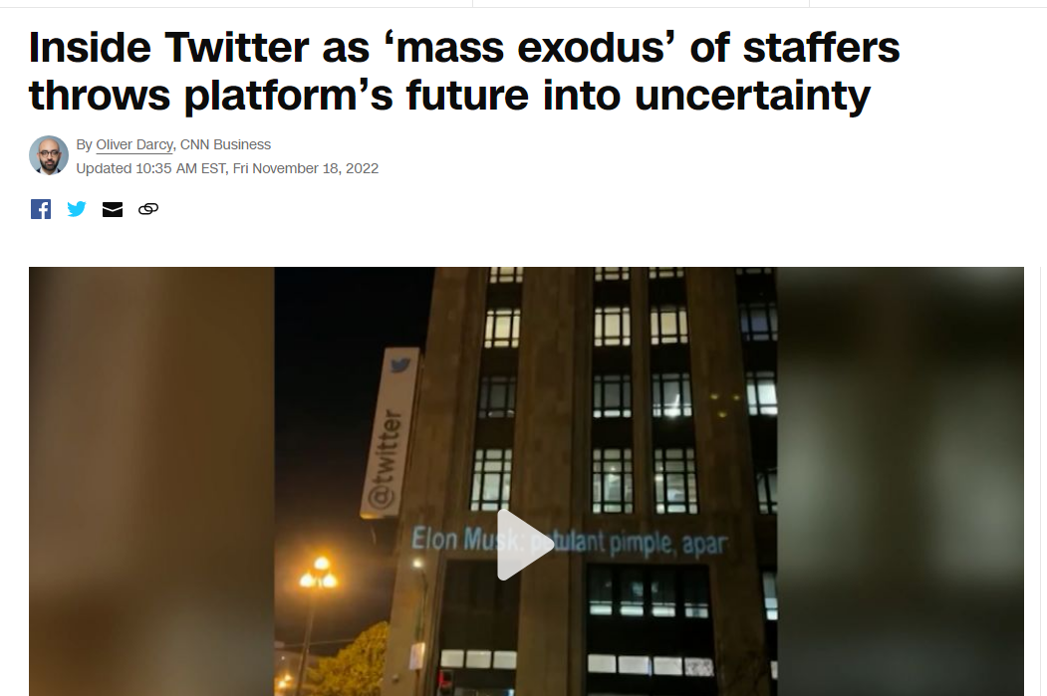
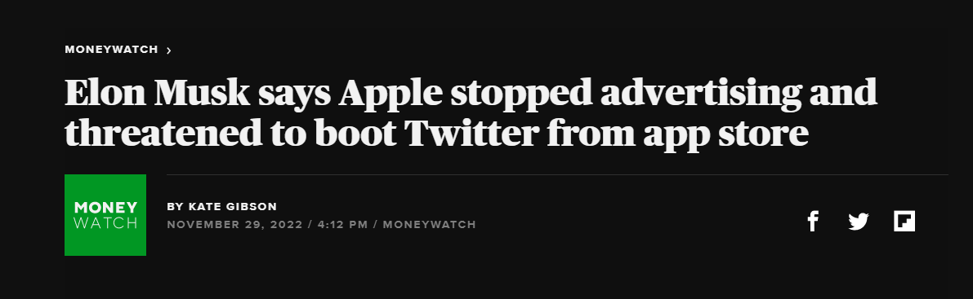
Notes:
vivek

Slide 2
Introducing
Wither
“The dead remains of Twitter”
Notes:
vivek

Slide 3
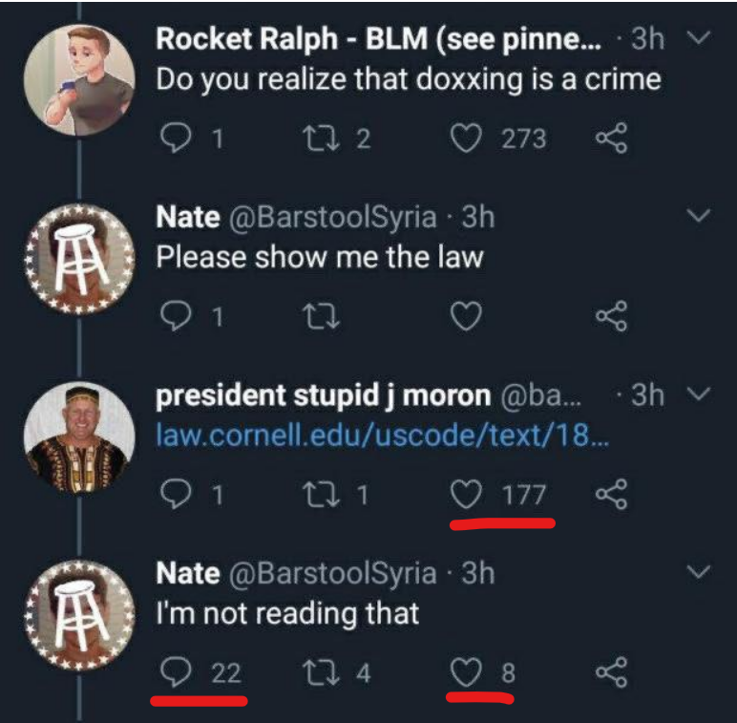
Motivation: Democratic Social Media App
Most social media platforms lack the option to dislike a post
And for those that do, disliking effectively does nothing
Platforms can be less toxic and more self-regulating if there were a better feedback system
Wither is able to achieve this
If a post is given enough negative reception (dislikes) compared to positive (likes), it will become permanently deleted
Notes:
vivek

Slide 4
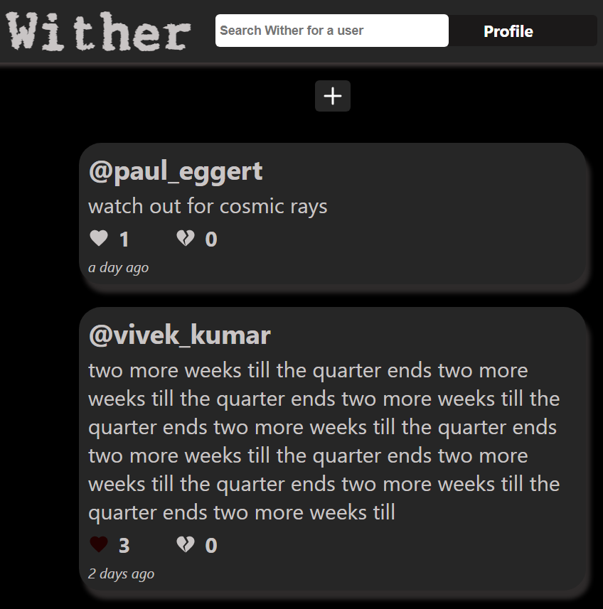
Home Page
Feature: Users can view a timeline of all appropriate posts by scrolling.
If the user is not signed in, posts from all users will be displayed.
If a user is signed in, display their posts and posts from all users they follow.
Posts will be ordered by oldest to newest.
Posts can be continually read by scrolling until there is nothing more to show.
Notes:
nick

Slide 5
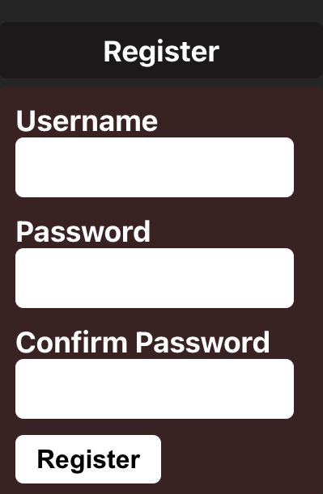
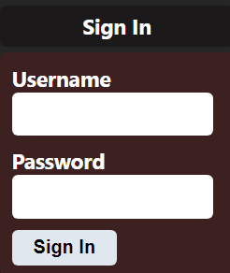
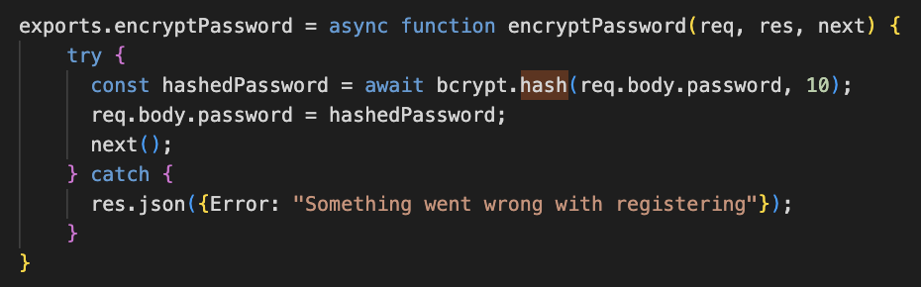
Creating an Account & Security
Feature: Users can register an account with an appropriate username and password
Passwords are encrypted and hashed using the bcrypt algorithm
Users are authenticated using bearer tokens
Tokens verify the identity of the requesting user
Notes:
ashley
quick intro to bcrypt
https://www.npmjs.com/package/bcrypt
https://en.wikipedia.org/wiki/Bcrypt
demo to show error messages
user 123 doesn’t meet requirement, change to ash_loong
passw 123 doesn’t meet requirement, change to qwer123!
user already exists, change to ash_loong2

Slide 6
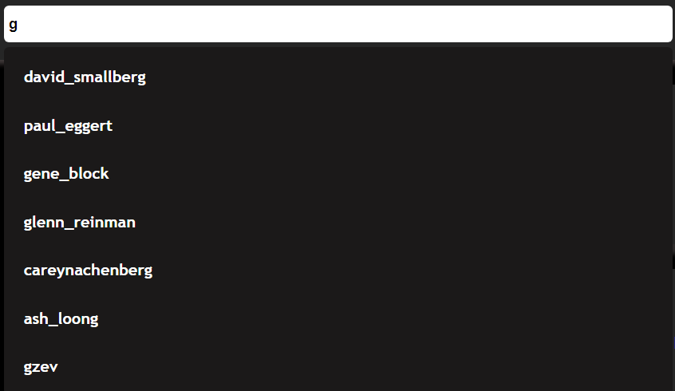
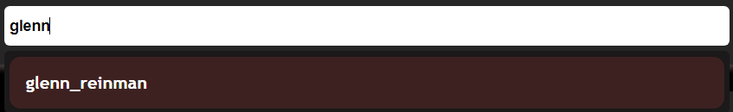
Querying
Users can query for other users and view their profile
Fetches the users matching the query parameters from the database
Notes:
george search bar: query other users to view their profile

Slide 7
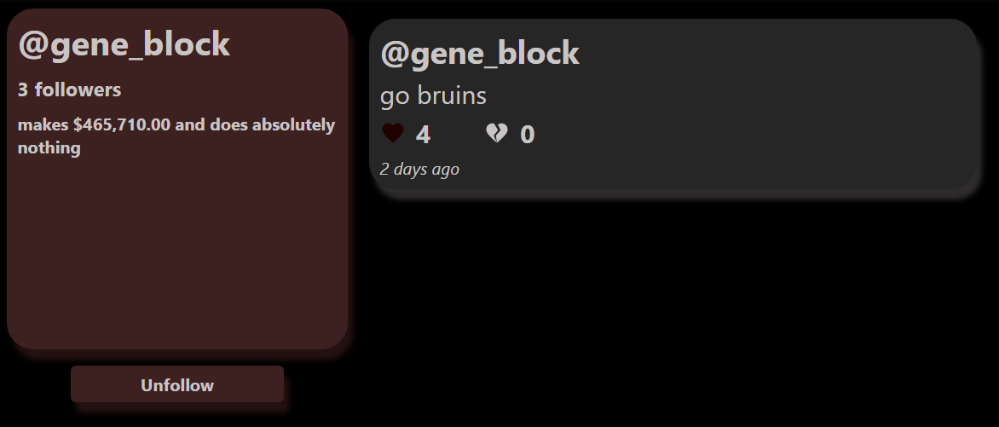
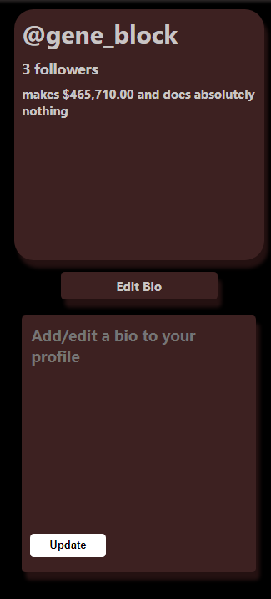
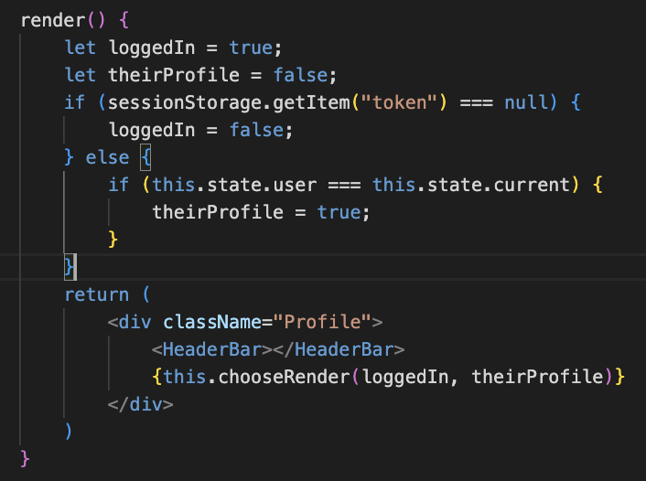
Viewing Profile Pages
Feature: Users can visit other profiles
Feature: Users can follow or unfollow other users
Following a user will update the home timeline to show their posts
Feature: Users can edit their own profile bio message for others to see
Notes:
ashley
conditional render of buttons
edit button: logged in, your profile
follow/unfollow: logged in, other user profile

Slide 8
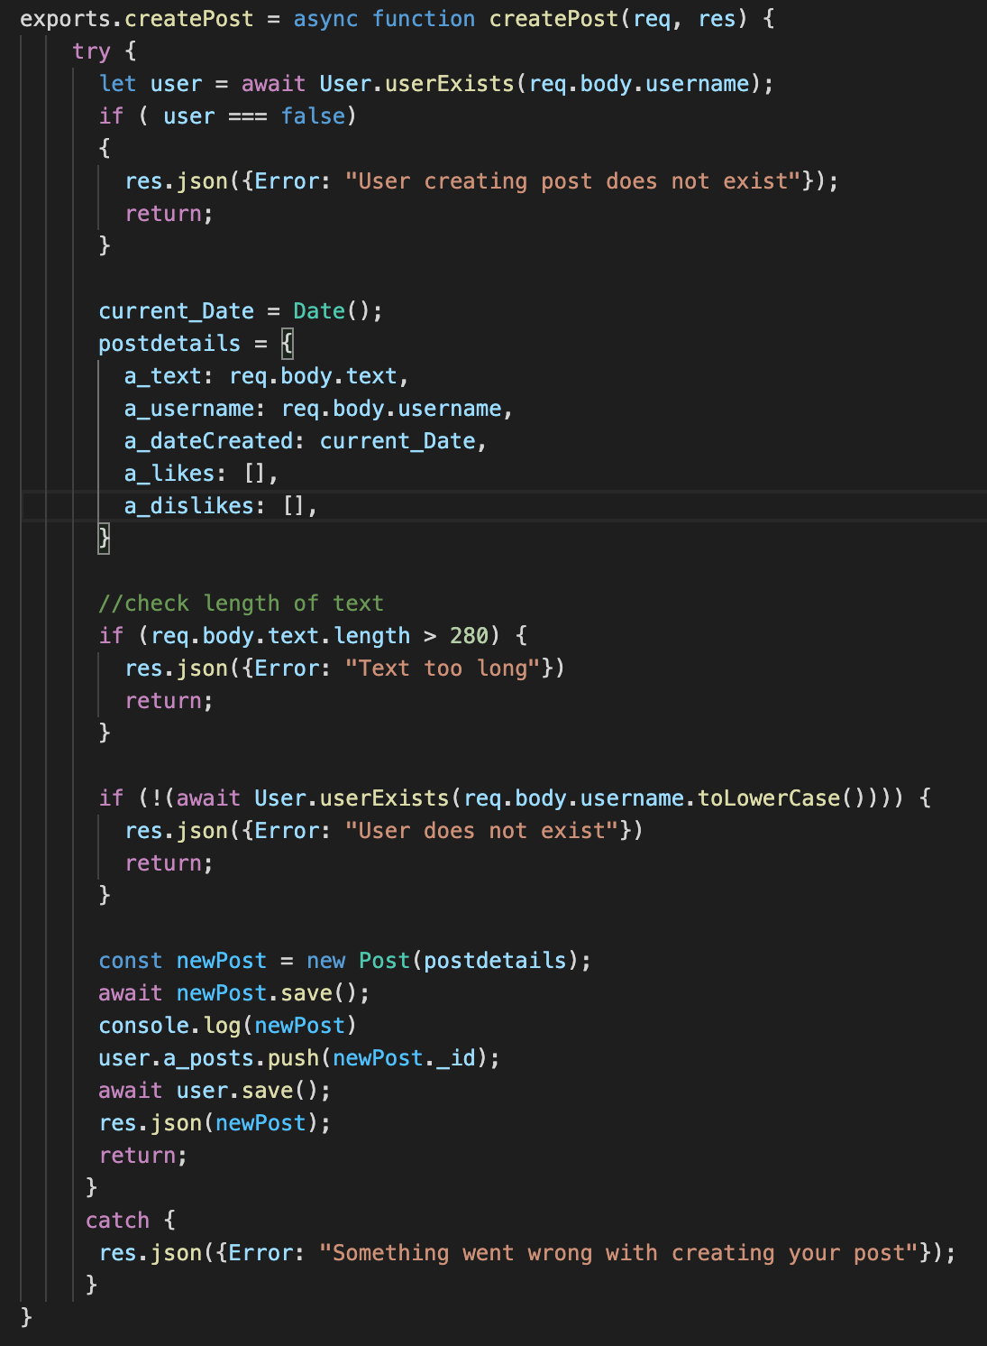
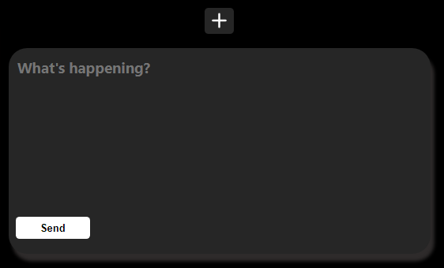
Creating Posts
Feature: Users can create text posts
Limited length
Post is displayed on the timelines of all of their followers and on their profile
Notes:
George
Create a post simply press + on the page and a user can create a new post
Checks in place to make sure user exists and can even create a post
Then check to make sure post is within a certain limit of characters (280 is our max)
Post then is created into the database, and pushed and connected with its respective user

Slide 9
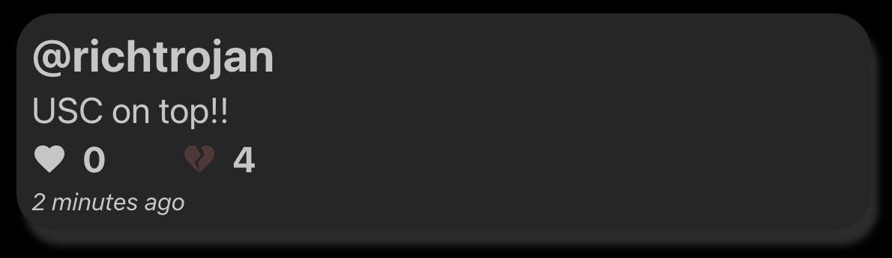
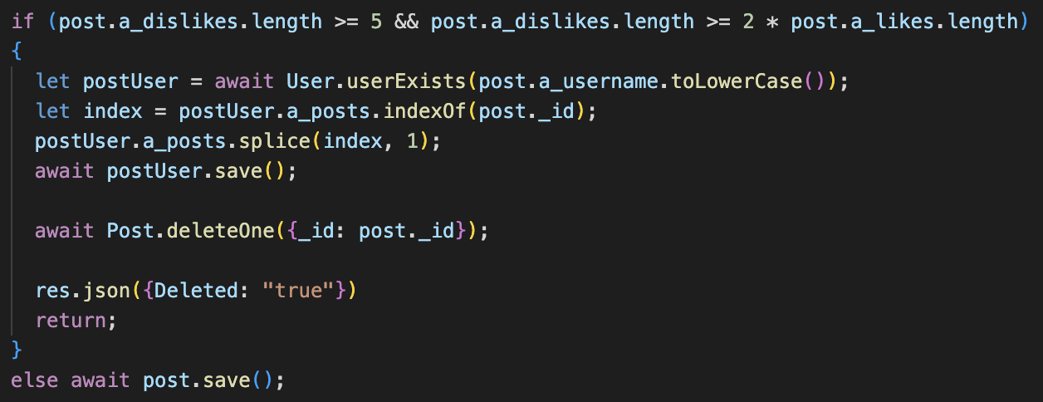
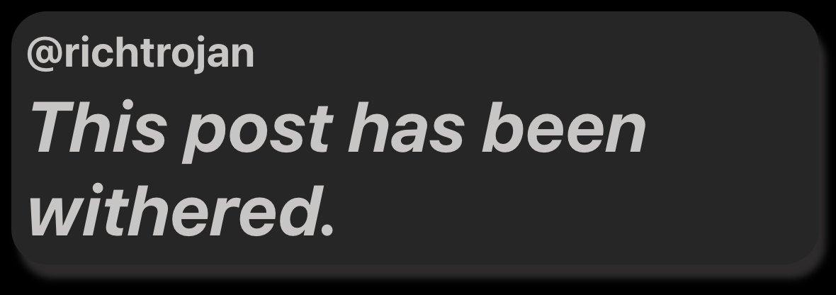
Liking and Disliking Posts
Features:
Like or Dislike Post
Post Removal
Post is “withered” and permanently deleted if:
Minimum of 5 dislikes
Twice the amount of dislikes than likes
Notes:
wonjin

Slide 10
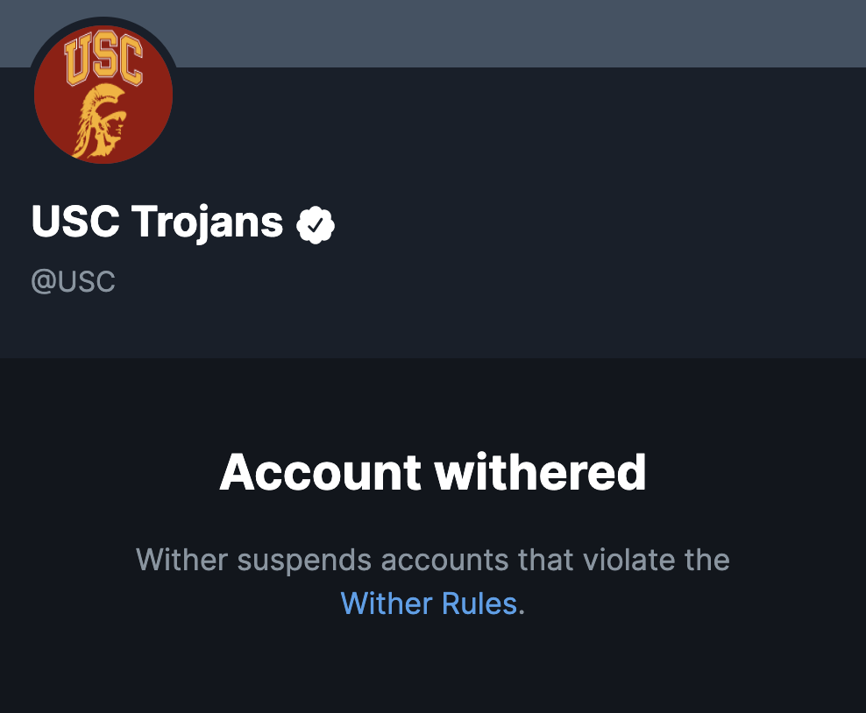
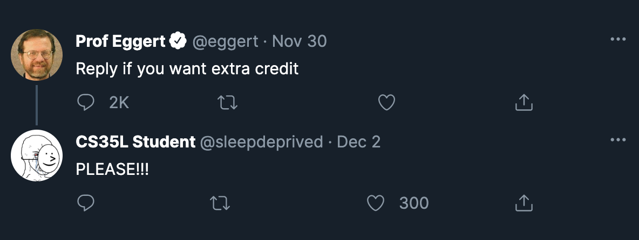
Possible Future Ideas
Allow users to reply to existing posts
User gets “withered” and permanently banned once 3 of their posts are “withered”
Notes:
wonjin

